Slide 1


Slide 2

"Hey there, I'm Nicol, your go-to Data Analyst for Flipkart Food Delivery. As a key part of our team, I use data to make sure our food orders arrive faster, smoother, and more personalized. I analyze customer preferences, track delivery trends, and optimize our operations so every meal gets to its destination on time. With the help of advanced analytics and machine learning, we can offer unique promotions and tailor every delivery to meet customer needs. As you progress in the storyline, I'll be right here to guide you with data-driven insights, helping you make smarter choices and ensuring every meal reaches its customer quickly and perfectly.

Slide 3
NOTE: To make this game learning and tricky, One can order their food by firing queries.. I’ll be there to assist you throught out the storyline. So let’s dive into this adventure!?

Slide 4
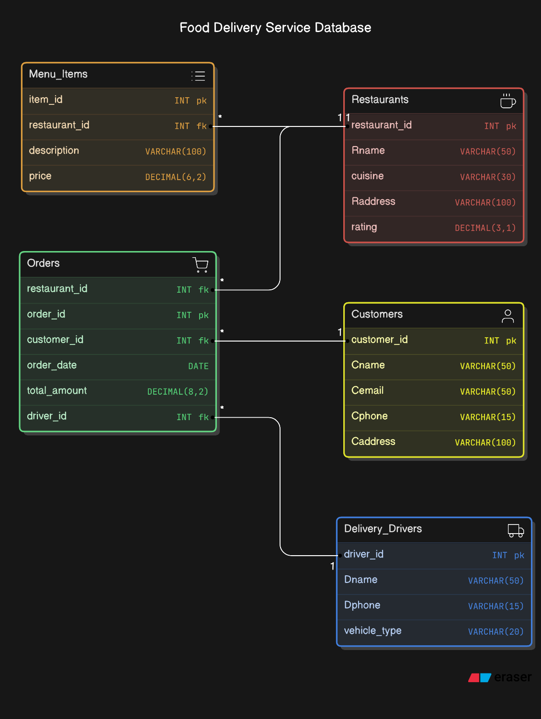
Here’s the ER Diagram

Slide 5
Here is the Unnormalized Form of Data of our Game
Customer_id INT
Cname VARCHAR(50)
Cemail VARCHAR(50)
Cphone VARCHAR(15)
Caddress VARCHAR(100)
restaurant_id INT
rname VARCHAR(50)
cuisine VARCHAR(30)
rating DECIMAL(3,1)
Raddress VARCHAR(100)
order_id INT
order_date DATE,
total_amount DECIMAL(8,2)
driver_id INT
Dname VARCHAR(50) Dphone VARCHAR (15)
vehicle_type VARCHAR(20)
item_id INT
description VARCHAR(100)
price DECIMAL(6,2)

Slide 6

Sr. No | Cid | Cname | Cemail | Cphone | Caddress | Rid | Rname | cuisine | rating | Radddress | oid | odate | Total_ amount | did | dname | Dphone | Vehicle_type | Item_id | description | price
1 | 101 | Ina | ina@x.com | 4563218901 | SDC.st | 1 | XYZ | IND | 4.5 | XYZ.st | 201 | 2024-09-13 | 100 | 301 | John | 9423456781 | Bike | 1 | Burger | 100
2 | 101 | Ina | ina@x.com | 4563218901 | SDC.st | 1 | XYZ | IND | 4.5 | XYZ.st | 201 | 2024-09-13 | 100 | 301 | John | 9423456781 | Bike | 2 | Fries | 150
1NF (FIRST NORMAL FORM)
Remove Repeating groups
Thus we need to remove repeating groups (for Example: multiple items or drivers in one row) and ensure each column contains only one value.

Slide 7

2 NF (SECOND NORMAL FORM)
Remove Partial Dependency, This means we must separate the data into multiple tables to remove partial dependency, such as separating orders, customers, restaurants, drivers, and items into different tables.
Customer_id INT
Cname VARCHAR(50)
Cemail VARCHAR(50)
Cphone VARCHAR(15)
Caddress VARCHAR(100)
restaurant_id INT
rname VARCHAR(50)
cuisine VARCHAR(30)
rating DECIMAL(3,1)
Raddress VARCHAR(100)
order_id INT
order_date DATE,
total_amount DECIMAL(8,2)
driver_id INT
Dname VARCHAR(50) Dphone VARCHAR (15)
vehicle_type VARCHAR(20)
item_id INT
description VARCHAR(100)
price DECIMAL(6,2)
Customers
Restaurants
Orders
Customer_id INT (PK)
Cname VARCHAR(50)
Cemail VARCHAR(50)
Cphone VARCHAR(15)
CaddressVARCHAR(100)
restaurant_id INT (PK)
rname VARCHAR(50)
cuisine VARCHAR(30)
rating DECIMAL(3,1)
Raddress VARCHAR(100)
Order_id INT (PK)
Order_date DATE
Total_amount DECIMAL(8,2)
Customer_id INT (FK)
Restaurant_id INT (FK)
Driver_id INT (FK)
Delivery_Drivers
Menu_items
Driver_id INT (PK)
Dname VARCHAR(50) Dphone VARCHAR (15)
Vehicle_type VARCHAR(20)
item_id INT (PK)
descriptionVARCHAR(100)
price DECIMAL(6,2)
Restaurant_id INT (FK)

Slide 8
3NF (THIRD NORMAL FORM)
No transitive dependencies. A transitive dependency occurs when one non-key attribute depends on another non-key attribute.
There will be no change from 2NF in Customers Table, Restaurants Table, Delivery_Drivers Table and Menu_items Table.
Orders Table is only modified to remove transitive dependency

Slide 9

FUNCTIONAL DEPENDENCY
A functional dependency is a relationship between two attributes in a database where one attribute (or a group of attributes) uniquely determines the value of another attribute. In simpler terms, if you know the value of one attribute, you can determine the value of another.
Restaurant_id → Rname, cuisine, Raddress, rating
Item_id → Restaurant_id, description, price
(item_id,restaurant_id) → Description, price
Order_id → Restaurant_id, customer_id, order_date,total_amount, driver_id
(order_id,restaurant_id) → Customer_id, order_date,total_amount, driver_id
Customer_id → Cname, Cemail, Cphone,Caddress
Delivery_Drivers → Dname, Dphone, vehicle_type

Slide 10
Creating Table & Inserting Values
CREATE TABLE Customers (
customer_id INT PRIMARY KEY,
Cname VARCHAR(50),
Cemail VARCHAR(50),
Cphone VARCHAR(15),
Caddress VARCHAR(100)
);
INSERT ALL INTO Customers(customer_id,Cname,Cemail,Cphone,Caddress) VALUES(1, 'John Doe', 'john@email.com', '555-1234', '123 Main St’)
INTO Customers(customer_id,Cname,Cemail,Cphone,Caddress) VALUES(2, 'Jane Smith', 'jane@email.com', '555-5678', '456 Elm St’)
INTO Customers(customer_id,Cname,Cemail,Cphone,Caddress) VALUES(3, 'Bob Johnson', 'bob@email.com', '555-9876', '789 Oak Ave’)
INTO Customers(customer_id,Cname,Cemail,Cphone,Caddress) VALUES(4, 'Alice Brown', 'alice@email.com', '555-4321', '321 Pine Rd’)
INTO Customers(customer_id,Cname,Cemail,Cphone,Caddress) VALUES(5, 'Charlie Wilson', 'charlie@email.com', '555-8765', '654 Maple Ln’)
select * from dual;
Here we’ve inserted values in our Customers table

Slide 11
Creating Table & Inserting Values
CREATE TABLE Restaurants (
restaurant_id INT PRIMARY KEY,
Rname VARCHAR(50),
cuisine VARCHAR(30),
Raddress VARCHAR(100),
rating DECIMAL(3,1)
);
INSERT ALL
INTO Restaurants(restaurant_id,Rname,cuisine,Raddress,rating) VALUES (1, 'Pasta Paradise', 'Italian', '111 Noodle St', 4.5)
INTO Restaurants(restaurant_id,Rname,cuisine,Raddress,rating) VALUES (2, 'Sushi Station', 'Japanese', '222 Fish Ave', 4.2)
INTO Restaurants(restaurant_id,Rname,cuisine,Raddress,rating) VALUES (3, 'Burger Bonanza', 'American', '333 Patty Rd', 3.8)
INTO Restaurants(restaurant_id,Rname,cuisine,Raddress,rating) VALUES (4, 'Taco Town', 'Mexican', '444 Salsa Ln', 4.0)
INTO Restaurants(restaurant_id,Rname,cuisine,Raddress,rating) VALUES (5, 'Curry Corner', 'Indian', '555 Spice Blvd', 4.7)
Select * from dual;
Here we’ve inserted values in our Restaurants table

Slide 12
Creating Table & Inserting Values
Here we’ve inserted values in our Delivery_Drivers table
CREATE TABLE Delivery_Drivers (
Driver_id INT PRIMARY KEY,
Dname VARCHAR(50),
Dphone VARCHAR(15),
vehicle_type VARCHAR(20)
);
INSERT ALLINTO Delivery_Drivers(Driver_id,Dname,Dphone,vehicle_type) VALUES(1, 'Mike Johnson', '555-1111', 'Car’)
INTO Delivery_Drivers(Driver_id,Dname,Dphone,vehicle_type) VALUES(2, 'Sarah Lee', '555-2222', 'Scooter’)
INTO Delivery_Drivers(Driver_id,Dname,Dphone,vehicle_type) VALUES(3, 'Tom Brown', '555-3333', 'Bicycle’)
INTO Delivery_Drivers(Driver_id,Dname,Dphone,vehicle_type) VALUES(4, 'Emily Davis', '555-4444', 'Car’)
INTO Delivery_Drivers(Driver_id,Dname,Dphone,vehicle_type) VALUES(5, 'David Wilson', '555-5555', 'Motorcycle’)
select * from dual;

Slide 13
Creating Table & Inserting Values
CREATE TABLE Orders (
order_id INT PRIMARY KEY,
customer_id INT,
restaurant_id INT,
driver_id INT,
order_date DATE,
total_amount DECIMAL(8,2),
FOREIGN KEY (customer_id) REFERENCES Customers(customer_id),
FOREIGN KEY (restaurant_id) REFERENCES Restaurants(restaurant_id),
FOREIGN KEY (driver_id) REFERENCES Delivery_Drivers(driver_id)
);
INSERT ALLINTO Orders(order_id, customer_id, restaurant_id, driver_id, order_date, total_amount) VALUES (1, 1, 3, 2, TO_DATE('2024-10-01', 'YYYY-MM-DD'), 25.99)
INTO Orders(order_id, customer_id, restaurant_id, driver_id, order_date, total_amount) VALUES (2, 2, 1, 1, TO_DATE('2024-10-02', 'YYYY-MM-DD'), 42.50)
INTO Orders(order_id, customer_id, restaurant_id, driver_id, order_date, total_amount) VALUES (3, 3, 5, 3, TO_DATE('2024-10-02', 'YYYY-MM-DD'), 35.75)
INTO Orders(order_id, customer_id, restaurant_id, driver_id, order_date, total_amount) VALUES (4, 4, 2, 4, TO_DATE('2024-10-03', 'YYYY-MM-DD'), 28.00)
INTO Orders(order_id, customer_id, restaurant_id, driver_id, order_date, total_amount) VALUES (5, 5, 4, 5, TO_DATE('2024-10-03', 'YYYY-MM-DD'), 18.99)
SELECT * FROM dual;
Here we’ve inserted values in our Orders table

Slide 14
Creating Table & Inserting Values
Here we’ve inserted values in our Menu_Items table
CREATE TABLE Menu_Items (
item_id INT PRIMARY KEY,
restaurant_id INT,
description VARCHAR(100),
price DECIMAL(6,2),
FOREIGN KEY (restaurant_id) REFERENCES Restaurants(restaurant_id)
);
INSERT ALLINTO Menu_Items(item_id,restaurant_id,description,price) VALUES(1, 1, 'Creamy pasta with bacon and eggs', 14.99)
INTO Menu_Items(item_id,restaurant_id,description,price) VALUES(2, 2, 'Crab, avocado, and cucumber roll', 8.50)
INTO Menu_Items(item_id,restaurant_id,description,price) VALUES(3, 3, 'Beef patty with cheddar cheese', 9.99)
INTO Menu_Items(item_id,restaurant_id,description,price) VALUES(4, 4, 'Grilled chicken and cheese in a tortilla', 11.25)
INTO Menu_Items(item_id,restaurant_id,description,price) VALUES(5, 5, 'Tender chicken in a creamy tomato sauce', 16.75)
select * from dual;

Slide 15

Hi, I’m Ina! I’m 17 years old, and I absolutely love trying new foods, especially when they’re delivered right to my door. That’s why I’m so excited about Flipkart Food Delivery.. Let’s jump into the game and order some food to munch…

Slide 16
Nicol: Hello little girl, How can I assist you today?
Ina: IDK what I’m craving for.. Can you help me with that!?
Nicol: Ohk! Let’s first check which restaurant are available in our premises.
Ina: select * from restaurants; like such?
Nicol: well that gives you all info about restaurants, if you just want restaurant’s name use Rname (column_name) instead of *.
Ina: Select Rname from restaurants;
Is this correct?
Nicol: Yes, Excellent.. So here’s the list of all restaurants..

Slide 17
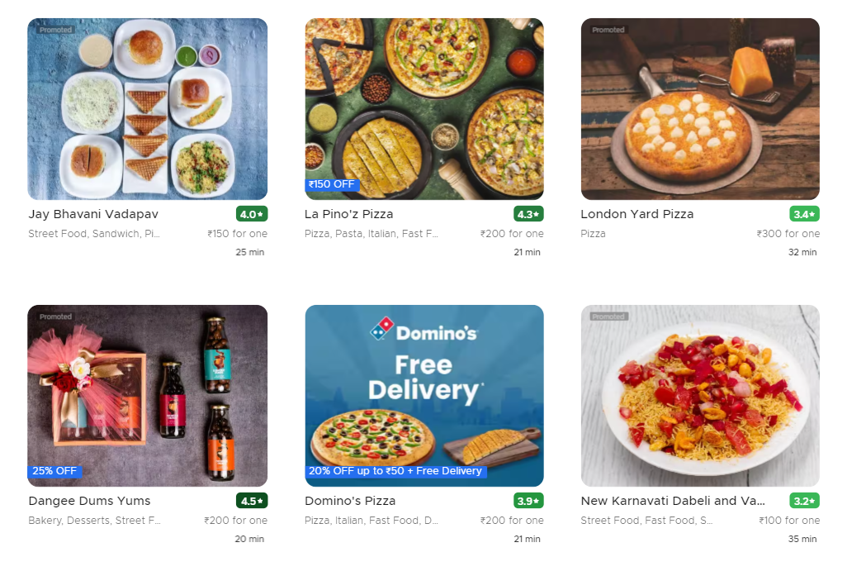
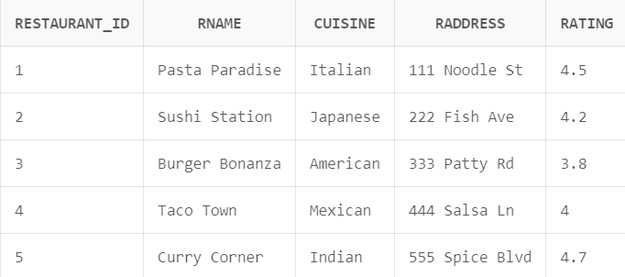

Slide 18
Ina: Wow, there are so many options! What types of cuisines are available?
Nicol: Great question! Let's find out the distinct cuisine types
Ina: How can we get distinct cuisine?
Nicol: We can use Distinct with the info we want to retrieve
Ina: Select Distinct cuisine from restaurants;
Nicol: Well that will only give cuisine’s name, no restaurant will be mentioned
Nicol: For getting cuisine(distinct one) with their restaurant use Distinct cuisine, Rname
Ina: Select Distinct cuisine, Rname from Restaurants;
Nicol: Perfect Ina!

Slide 19
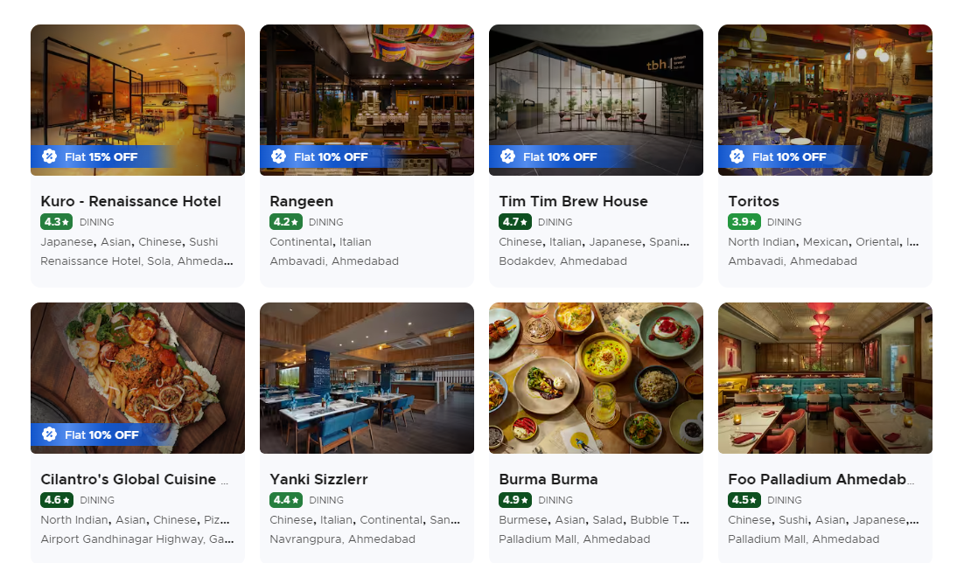
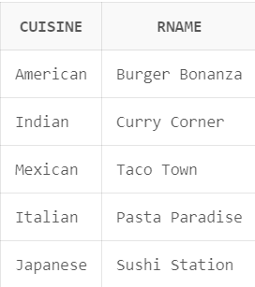

Slide 20
Ina: I prefer eating at highly-rated restaurants.
Nicol: For that you got to use ‘where’ with your condition.
Ina: Can you give me an example?
Nicol: Sure, here’s one.. Select * from restaurants where cuisine = ‘Italian’;
Ina: Select Rname, cuisine from restaurants where ratings = 5; would this work too?
Nicol: Yes it would, You
can also do this,
where rating >= 4;
Ina: Oh, Got it!

Slide 21
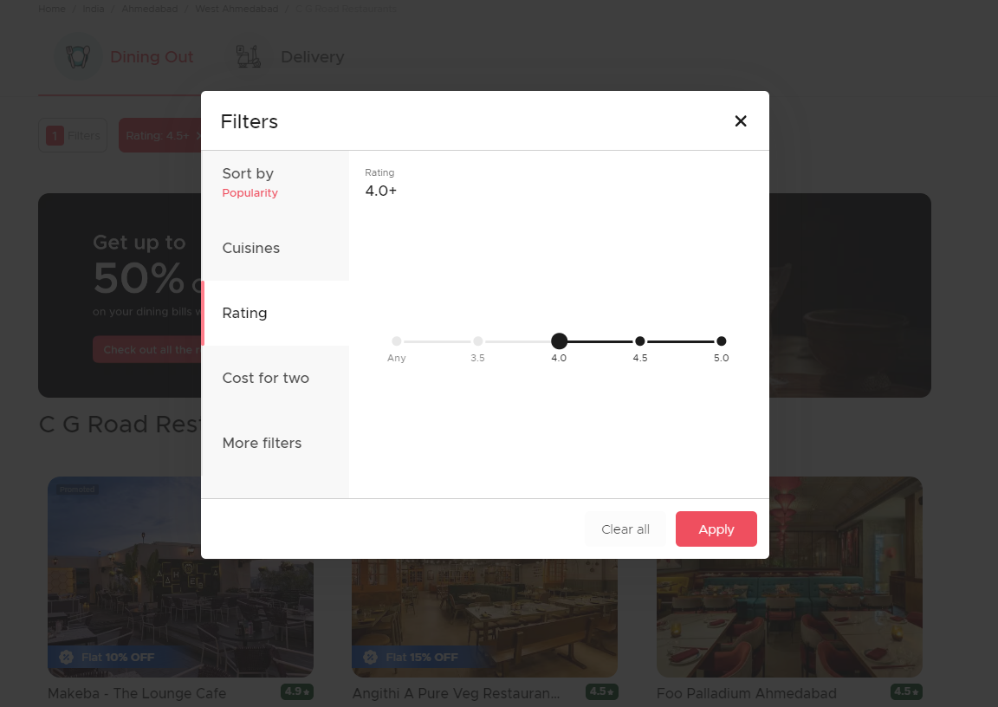
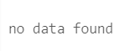

Slide 22
Ina: How can I sort them by their rating?
Nicol: Well you can use ‘Order by’ to sort any info as per requirement
Ina: Can you give example..
Nicol: Here’s an example, (DEFAULT: ASC)
Select * from restaurants order by Rname;
Nicol: example for descending,
Select * from restaurants order by Rname DESC;
Ina: Uhm, then is this correct? Select Rname, rating from Restaurants order by rating DESC;
Nicol: Yes it’s correct Ina!

Slide 23
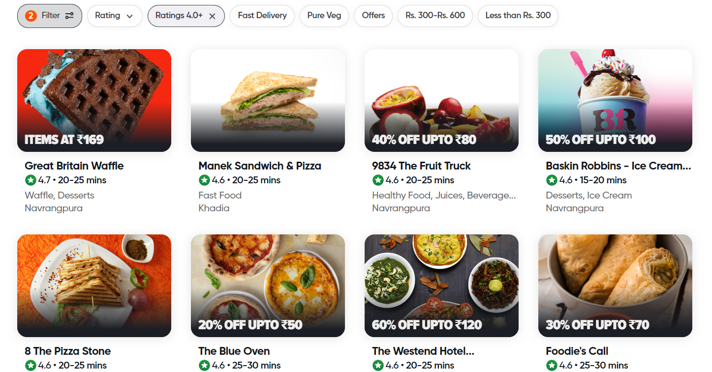
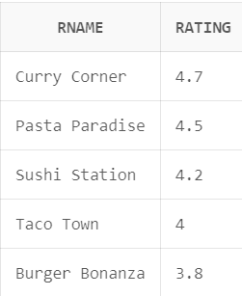

Slide 24
Ina: I'm in the mood for either Italian or Japanese food.
Ina: And I also want it’s rating to be above 4.
Nicol: So basically you want Italian or Japanese restaurants with a rating above 4.0
Ina: Yes! You’re right..
Nicol: You can use ‘OR’ with where when you want either one of the option and ‘AND’ when you want both option..
Ina: where (rating = 4 OR 5) AND price < 500; Like this?
Nicol: You can’t write rating = 4 OR 5 Ina.
Ina: And why so?

Slide 25
Nicol: Because the OR operator needs two complete conditions on either side to evaluate properly.
Nicol: You can also use the IN operator, like..
Select * from restaurants where rating IN (4,5);
Nicol: Now you try yourself..
Ina: Yup!
Select Rname,cuisine,rating from restaurants
Where(cuisine = 'Italian' OR cuisine = 'Japanese’)
AND rating > 4.0;
Nicol: Good job Ina!

Slide 26
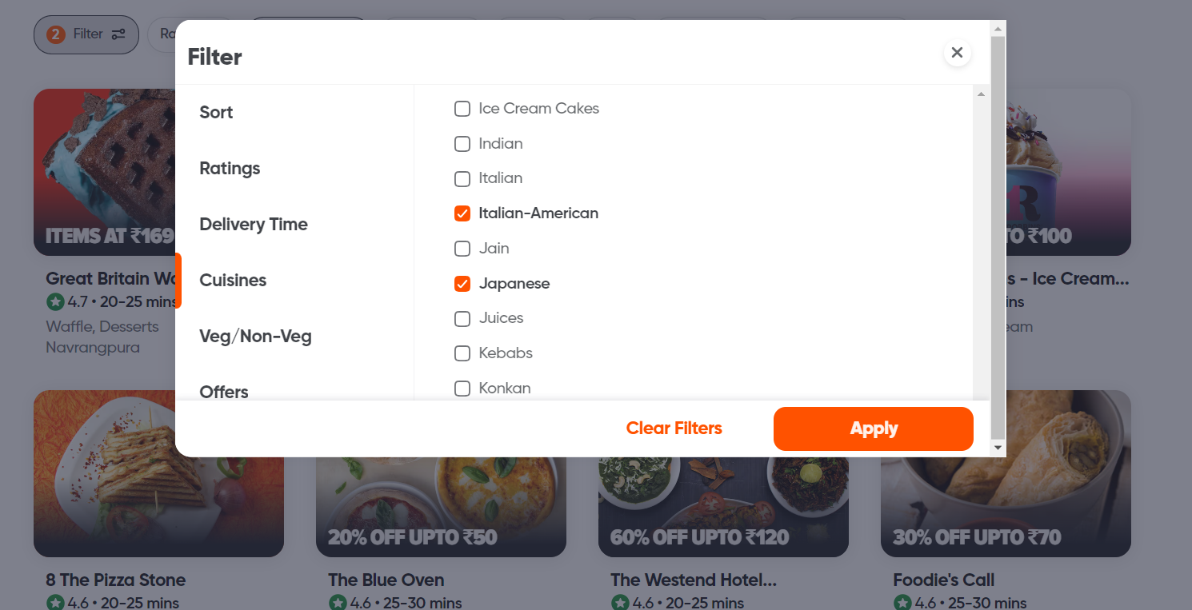
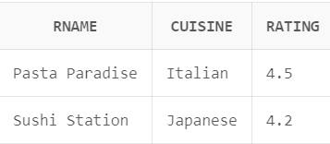

Slide 27
Ina: Well I think I’ll place my order now, how can I add myself in the customer’s list?
Nicol: For that we will use ‘insert’ to add your info in our customer’s table
Ina: How?
Nicol: when no specific information is to be inserted we use,
Insert into table_name values (value1, value2, value3, ...);
Nicol: Else we use, Insert into table_name (column1, column2, column3, ...) Values (value1, value2, value3, ...);
Ina: Insert into Customers(customer_id, Cname, Cemail, Cphone, Caddress) values (6, 'Ina Green', 'ina@email.com', '555-9999', 'not provided’); like such?
Nicol: Cool Ina!

Slide 28
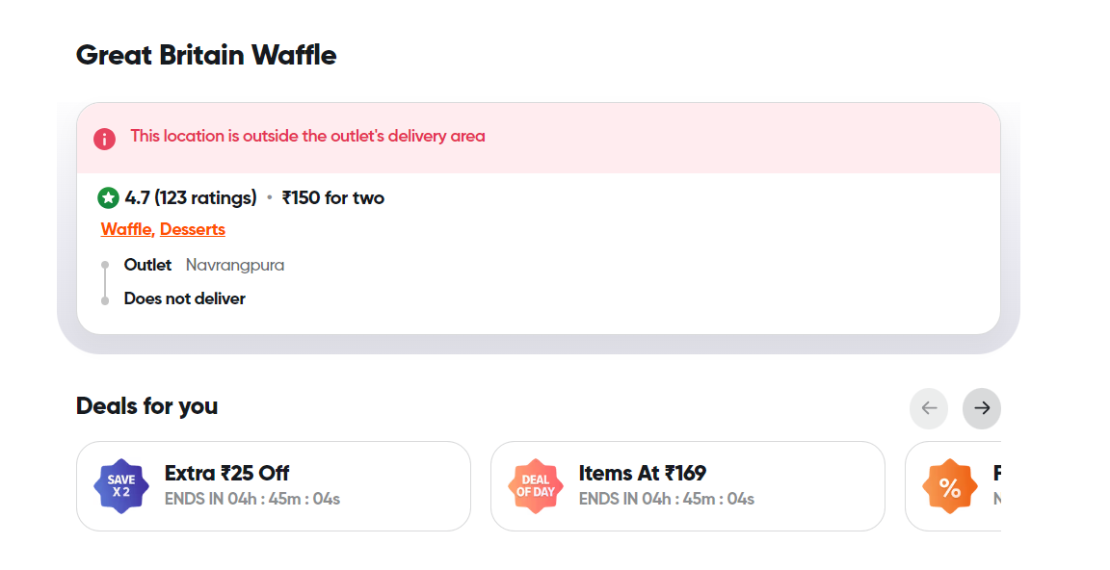
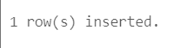

Slide 29
Ina: Well, How can I update ratings of my favourite restaurant?
Nicol: Here’s a way of how you can update info
UPDATE table_name
SET column1 = value1, column2 = value2, ...
WHERE condition;
Ina: Would this work?
Update Restaurants
Set rating = 4.8
Where Rname = ‘Pasta Paradise’;
Nicol: Yes, perfect!
Nicol: Just make sure to use where
clause carefully. If you omit
where clause all the records
in the table would get updated.
Ina: Ohki, Gotcha!

Slide 30
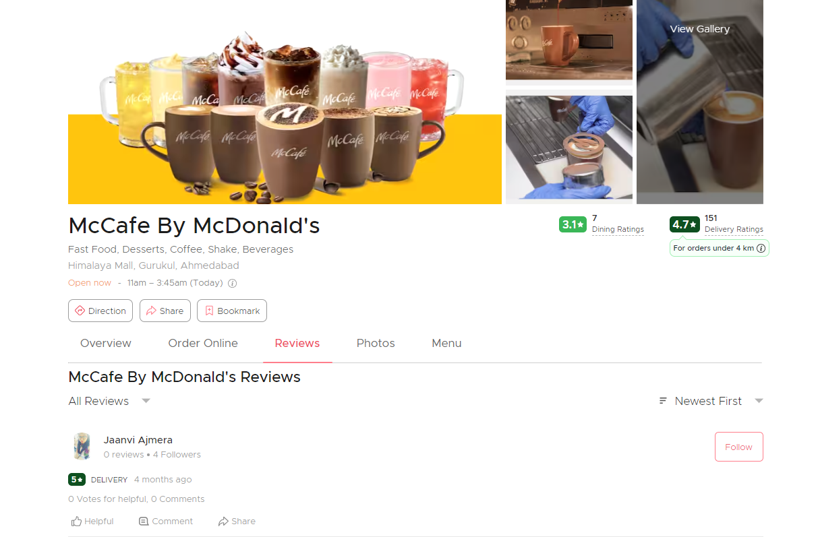
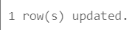

Slide 31
Ina: Can you also tell me How I can get the average price of menu items? I need to check budget for my order.
Nicol: Sure! For this you got to use avg() function.
Nicol: Here’s an example,
Select avg(rating) from Restaurants;
Ina: like such?
Select avg(price) from Menu_Items;
Nicol: Yes!
Nicol: Note that NULL values are ignored.

Slide 32
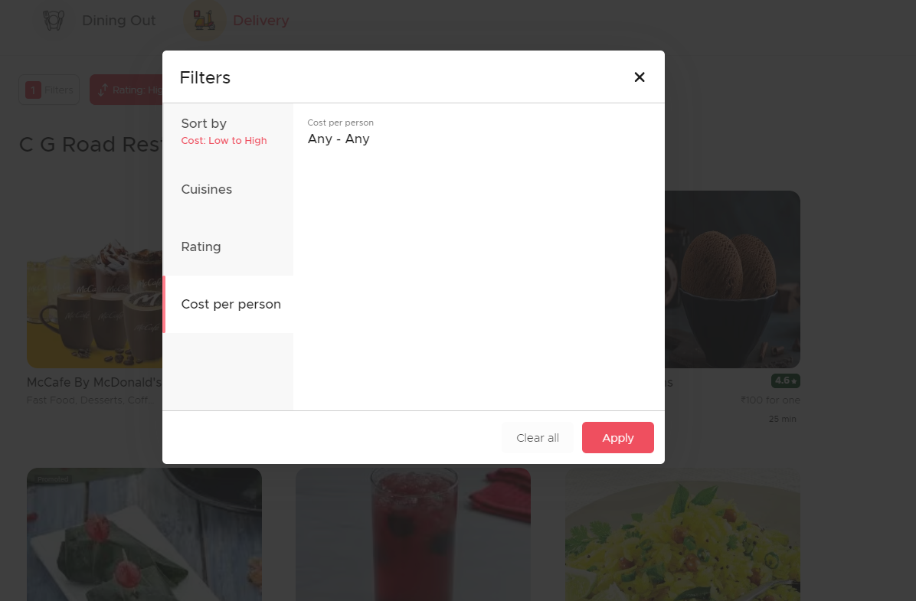
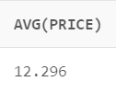

Slide 33
Ina: Well, How can I check for NULL Values?
Nicol: Here’s the how you can check,
Select column_names from table_name
where column_name IS NULL;
Ina: select rating from Restaurants where rating is NULL;
Nicol: Correct Ina! You can also check for info that are not NULL
Ina: How?
Nicol: By replacing IS NULL by IS NOT NULL
Ina: Oo Interesting!

Slide 34
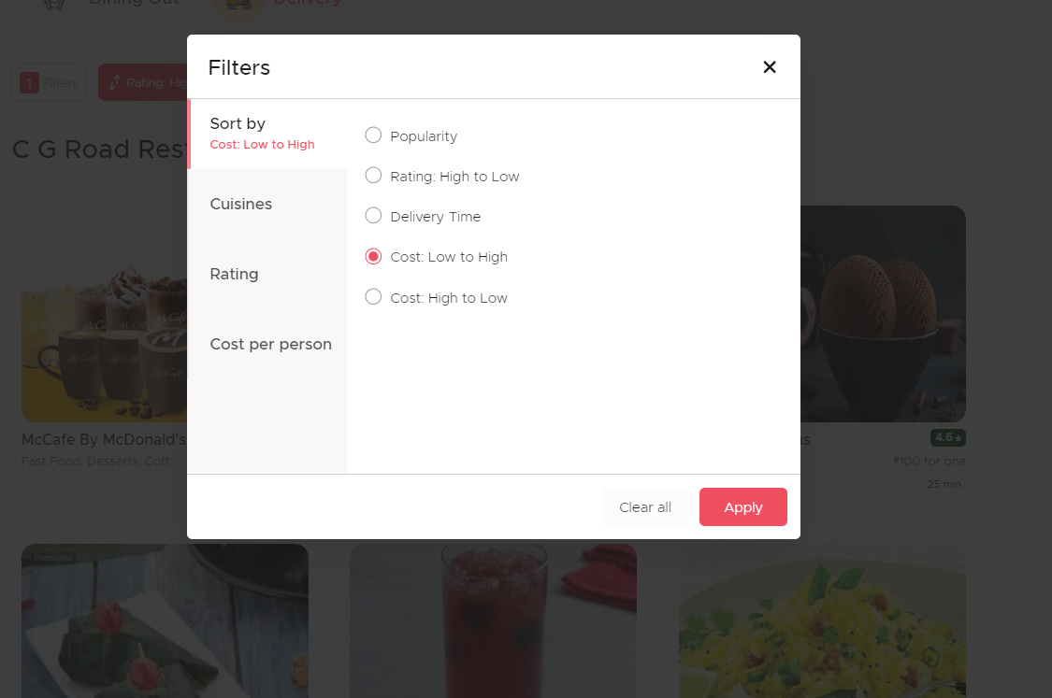


Slide 35
Ina: How can I get the restaurant list in a more readable format?
Nicol: You can use Alias, which is nothing but a temporary name of column-name
Ina: How can I use it?
Nicol: here’s an example,
Select Customer_id AS ID from Customers;
Ina: Oo would this work?
Select Rname AS Restaurants , rating AS score from restaurants
Nicol: Yes Ina! Good

Slide 36
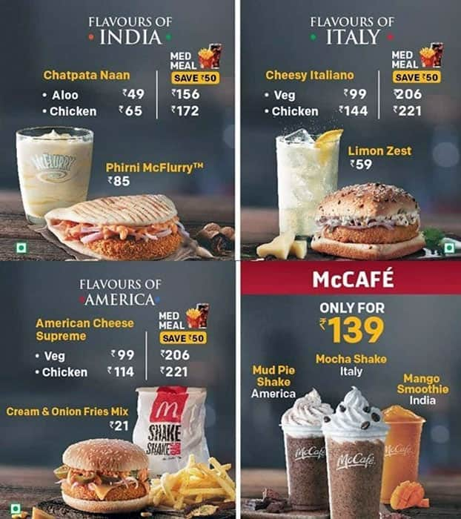
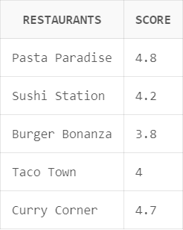

Slide 37
Ina: Well now I'm curious about the menu variety.
Ina: How many items does each restaurant offer?
Nicol: For that you got to use count (similar to avg)
Nicol: And joins which is used to combine rows from two or more table , based on a related column between them
Ina: Ohk, I want to join menu-items and restaurants table
Nicol: There are many different types of joins
(left, right, full etc)
among which we’re gonna use left join for this
Ina: Ohk! But why left join?

Slide 38
Nicol: Because the left join keyword returns all records from the left table(table 1), and the matching records from the right table(table 2)
Nicol: Here’s the syntax of left join..
Select column_name(s) from table1
Left join table2
ON table1.column_name = table2.column_name;
Nicol: Oo what’s right join then and full join?
Nicol: Note that right join returns all rows from the right table, even if there are no matches in the left table
Nicol: Here’s the syntax of right join
Select column_name(s) from table1
RIGHT JOIN Table2
ON table1.column_name = table2.column_name;

Slide 39
Ina: Oo
Nicol: And full join is the keyword that returns all records when there is a match in left( table 1) or right (table 2) table records
Nicol: Here’s the syntax of full join
Select column_name(s) from table1
FULL OUTER JOIN table2
ON table1.column_name = table2.column_name
WHERE condition;
Ina: Okay!
Nicol: Why don’t you give it a try Ina!
Ina: SELECT R.Rname, COUNT(M.item_id) AS ItemCount
from Restaurants R
Left join Menu_Items M
ON R.restaurant_id = M.restaurant_id
GROUP BY R.restaurant_id, R.Rname;

Slide 40
Ina: Is it correct?
Nicol: Yes Ina, Now try for right join..
Ina: Select R.Rname, M.description, M.price
from Restaurants R
Right Join Menu_Items M
on R.restaurant_id = M.restaurant_id;
Nicol: Good Job Ina, How about full join?
Ina: Select R.Rname, M.description, M.price
from Restaurants R
Full outer join Menu_Items M
on R.restaurant_id = M.restaurant_id;
Nicol: Good Job Ina!
Nicol: Note that in few
databases we use
left outer join rather then
left join and vice versa for right and full
Ina: Ohk! Gotcha!

Slide 41
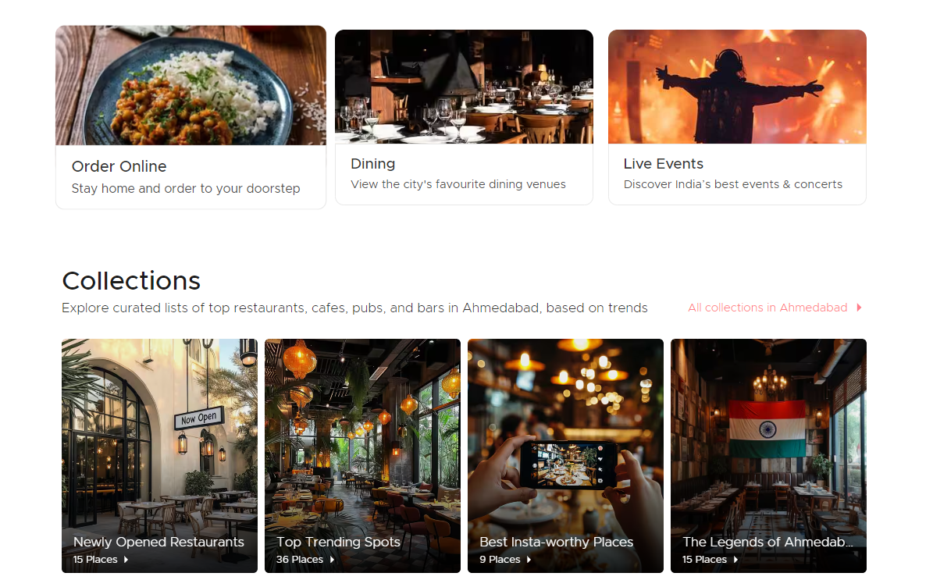
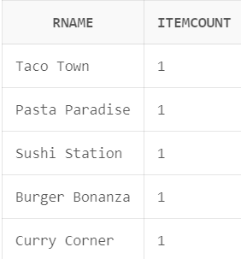

Slide 42
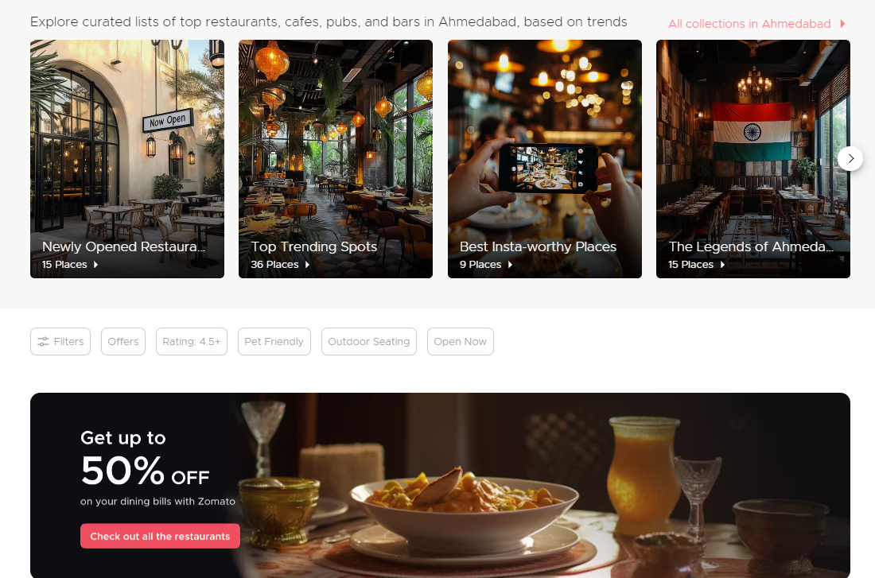
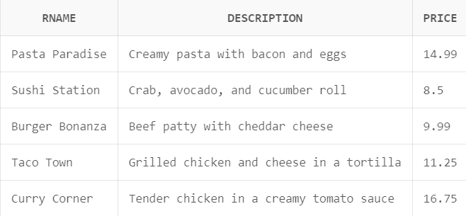

Slide 43
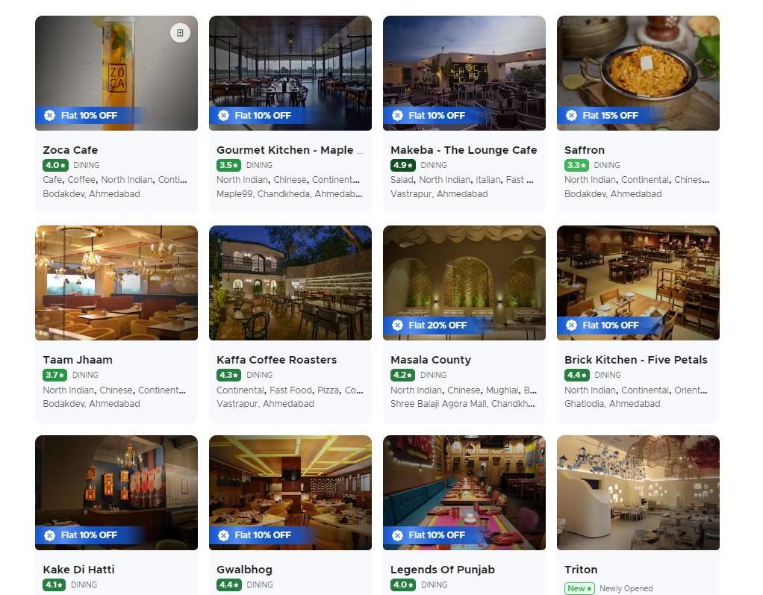
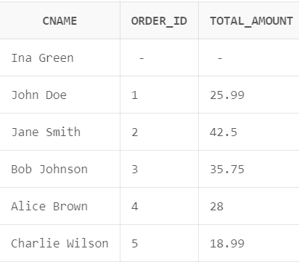

Slide 44
I hope you enjoyed our small storyline and got to learn something new too..
Here are some practice questions which you guys can prefer.

Slide 45
SR NO | AI Generated Q/A | Updated Q/A
Q1: | Get all customer information | Get customers and address from customers;
Ans 1: | SELECT * FROM Customers; | Select Cname as Customer, Caddress as Address from customers;
Q2: | Get distinct cuisines from the Restaurants table: | Get distinct cuisines from the Restaurants table where ratings are above 4.5
Ans 2: | SELECT DISTINCT cuisine FROM Restaurants; | Select Distinct Rname from restaurants where rating >4.5;
Q3: | Get orders with total amount greater than 30: | Get order_id with total amount less than 150
Ans 3: | SELECT * FROM Orders WHERE total_amount > 30; | Select order_id from Orders where total_amount < 150;

Slide 46
SR NO | AI Generated Q/A | Updated Q/A
Q4: | Get all restaurants ordered by their rating in descending order: | Get all restaurants order by their rating in Ascending order
Ans 4: | SELECT * FROM Restaurants ORDER BY rating DESC; | Select * from Restaurants Order by rating;
Q5: | Get all orders with a total amount greater than 30 and ordered after '2024-10-01': | Get all orders with a total amount less than 150 and ordered before ‘2024-10-01’
Ans 5: | SELECT * FROM Orders WHERE total_amount > 30 AND order_date > '2024-10-01'; | Select * from orders where total_amount < 150 and order_date < ‘2024-10-01’;
Q6: | Get restaurants with rating either rating = 4 OR rating 5 | Get restaurant_id and it’s name where restaurant_id is less than 2 or equal to 5
Ans 6: | Select Rname from Restaurants where rating = 4 OR rating = 5; | Select Rname, Restaurant_id from restaurants where restaurant_id < 2 OR restaurant_id = 5;

Slide 47
SR NO | AI Generated Q/A | Updated Q/A
Q7: | Get all customers who do not live at '123 Main St': | Get all order Id who are not NULL
Ans 7: | SELECT * FROM Customers WHERE NOT Caddress = '123 Main St'; | Select order_id from orders where order_id is not null;
Q8: | Insert a new customer into the Customers table: | Insert a new restaurant into the restaurants table
Ans 8: | INSERT INTO Customers (customer_id, Cname, Cemail, Cphone, Caddress) VALUES (6, 'David Green', 'david@email.com', '555-9999', '789 Cedar St'); | Insert into Restaurants (restaurant_id,Rname,cuisine,Raddress,rating) values (6,’Italiano’, ’Italian’, ‘St- 54, west’,4.9);

Slide 48
SR NO | AI Generated Q/A | Updated Q/A
Q9: | Update the rating for restaurant 'Burger Bonanza': | Update rating for restaurant ‘Italiano’ to 4.5
Ans 9: | UPDATE Restaurants SET rating = 4.0 WHERE Rname = 'Burger Bonanza'; | Update Restaurants set rating = 4.5 where Rname = ‘Italiano’;
Q10: | Delete an order with order ID 3: | Delete an customer with it’s ID 2
Ans 10: | DELETE FROM Orders WHERE order_id = 3; | Delete from customers where customer_id = 2;
Q11: | Count the total number of orders: | Count the total numbers of customers
Ans 11: | SELECT COUNT(*) AS total_orders FROM Orders; | Select count(*) AS No_of_customers from customers;

Slide 49
SR NO | AI Generated Q/A | Updated Q/A
Q13: | Calculate the total revenue from all orders: | Calculate the total customers
Ans 13: | SELECT SUM(total_amount) AS total_revenue FROM Orders; | Select SUM(customer_id) AS total_customers from customers;
Q14: | Get the average rating of all restaurants: | Get the average price of all restaurants
Ans 14: | SELECT AVG(rating) AS avg_rating FROM Restaurants; | Select avg(total_amount) AS avg_price from orders;
Q15: | Find the highest and lowest rated restaurants: | Find the highest and lowest price
Ans 15: | SELECT MIN(rating) AS min_rating, MAX(rating) AS max_rating FROM Restaurants; | Select min(total_amount) AS min_price, Max(total_amount) AS max_price from orders;

Slide 50
References:
Claude AI
CHAT GPT
Draw.io
Sir’s notes
Eraser.Io
PROMPTS:
Can you get me a DBMS game based upon online food delivery (say Zomato) also get me storyline for this game that makes logically sense my requirements are:
1) maximum 5 tables
2) get me raw data upto 10 rows of each table
3) ER diagram
4) normalisation (compulsory to work)
5) state example of joins using the tables
6) in the following game make simple questions from each topic stated below: 1 select 2 select distinct 3 where 4 order by 5 and, OR, not 6 insert into 7 null values 8 update, delete, aggregate functions 9 alias 10 all types of joins, group by 11 union
7) my last requirement is, get me 10 questions from this above game

Slide 51
PROMPTS CONTINUE:
1) from the above data get me the photo of ER diagram 2) generate the raw data of the tables in such a way that it needs to be normalized 3) use normalisation and explain each normalisation using photo of tables 4) from the 6th requirement from above data that is make simple questions from topic, get me the question that collabs with the storyline.
consider storyline as suppose a guy name Nicol want to order food... and make give answer fully from above prompt
get me the ER diagram with it's attribute from above data in an image format
From above data switch the storyline from Nicol to name Ina. Let nicol interact with Ina
Get me questions from above storyline regarding joins
Check whether this function dependency of given table are correct
Get me ER diagram from following data of tables

Slide 52
PROJECT BY:
PRIYANKA PATEL BTECH CSE (SEM 3)
202307020081
THANK YOU

